Slide 1

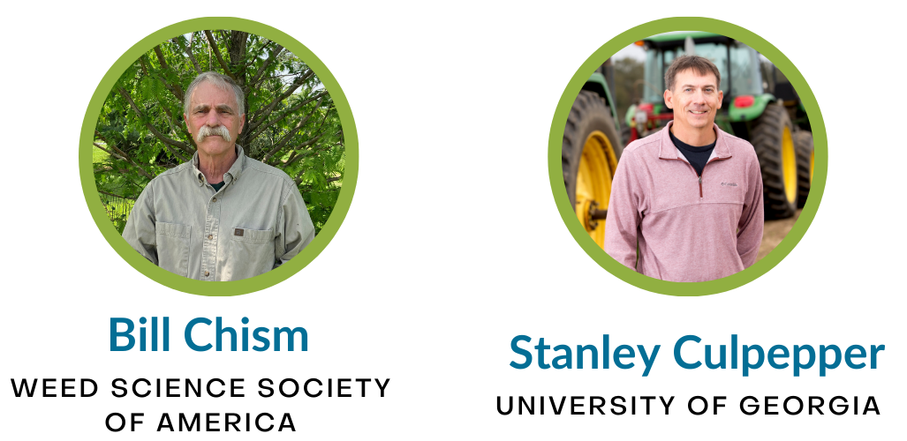
July 11, 2023
How To Protect
Endangered Species While Feeding The World

Slide 2




NCFAR is a nonprofit, nonpartisan, consensus-based, and customer-led coalition that brings together food, agriculture, nutrition, conservation, and natural resource stakeholders to serve as a forum and unified voice supporting increased federal investment in USDA Research, Education, and Economics.
Advocacy
Education
Communication

Slide 3







Thank you!
Sponsors:
Collaborators:
Extension Committee on Organization & Policy (ECOP)

Slide 4
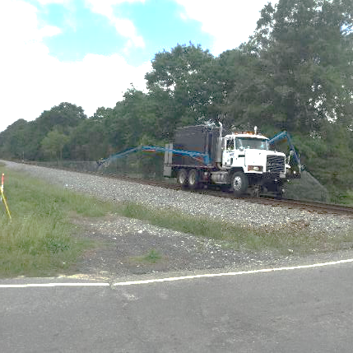
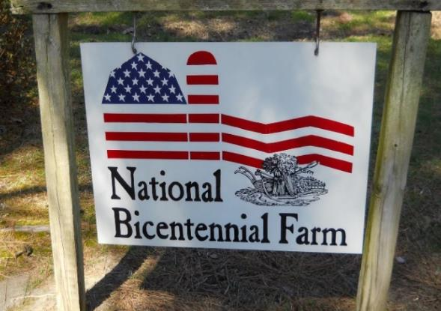
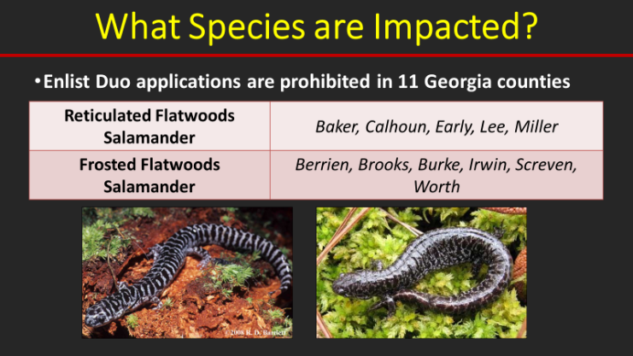

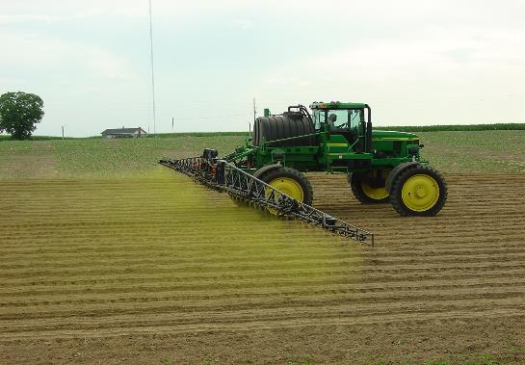
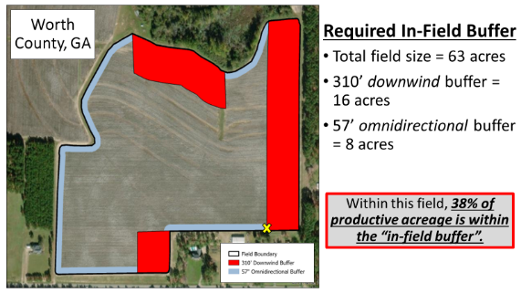
How To Protect Endangered Species While Feeding The World
Stanley Culpepper and Bill Chism
Weed Science Society of America

Slide 5
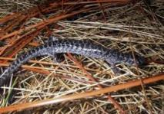

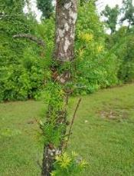

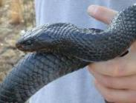
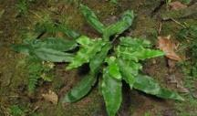


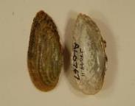
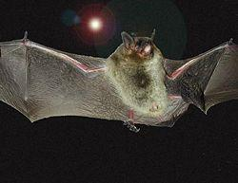
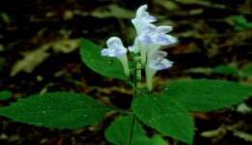
Endangered Species Act (ESA)
ESA implemented in 1973 to protect animals, fish, and plants
Provides framework to conserve & protect endangered & threatened species & their habitats!
Total of >1800 species, over 900 are plants and another 900 critical habitats nationally!!!
Notes:
NOAA list 163 marine species. FWS lists 941 plants and 737 animals = 1841 and 923 species with critical habitat.

Slide 6
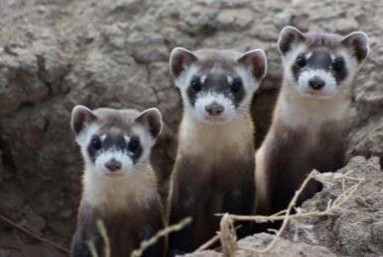

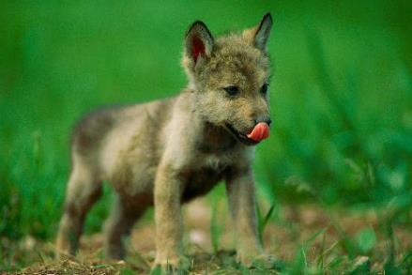
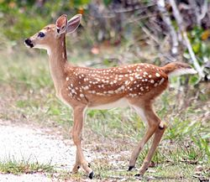


When you think of Endangered Species…..
Black-footed Ferret
Grey Wolf
Grizzly Bear
Key Deer
Wood Bison
Riparian Brush Rabbit

Slide 7

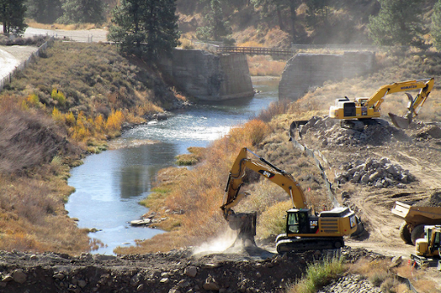
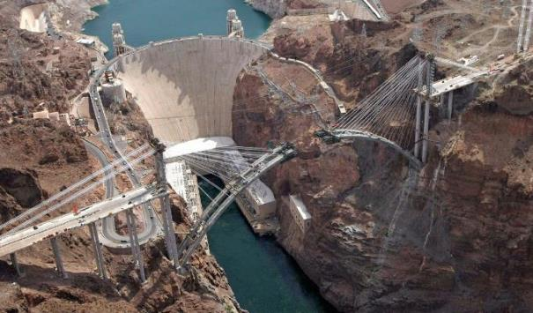
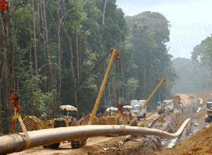
When you think of Endangered Species…..
Construction projects, building highways, damming rivers….???

Slide 8
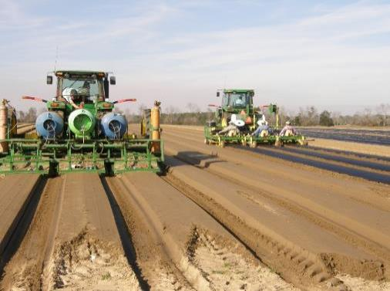
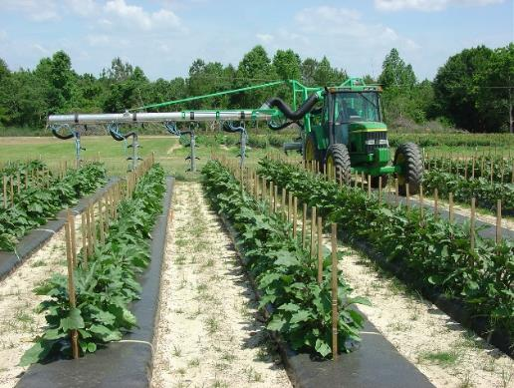
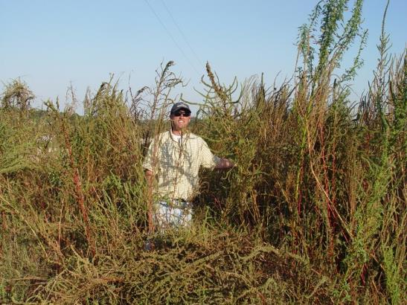
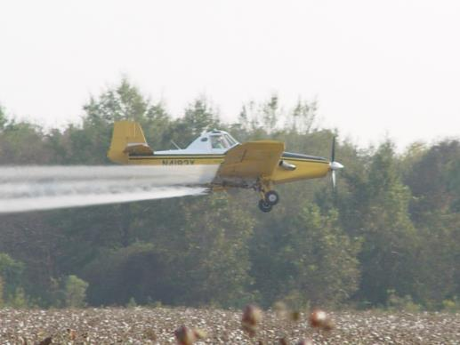
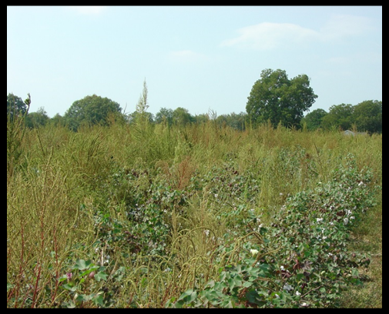
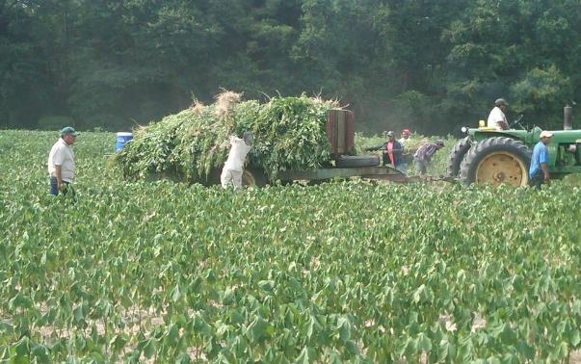
What you Probably Don’t Think About….
Production agriculture & the practical use of pesticides to control troublesome pests

Slide 9
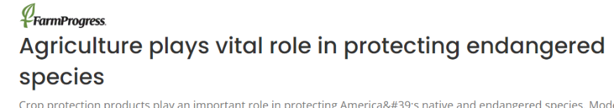
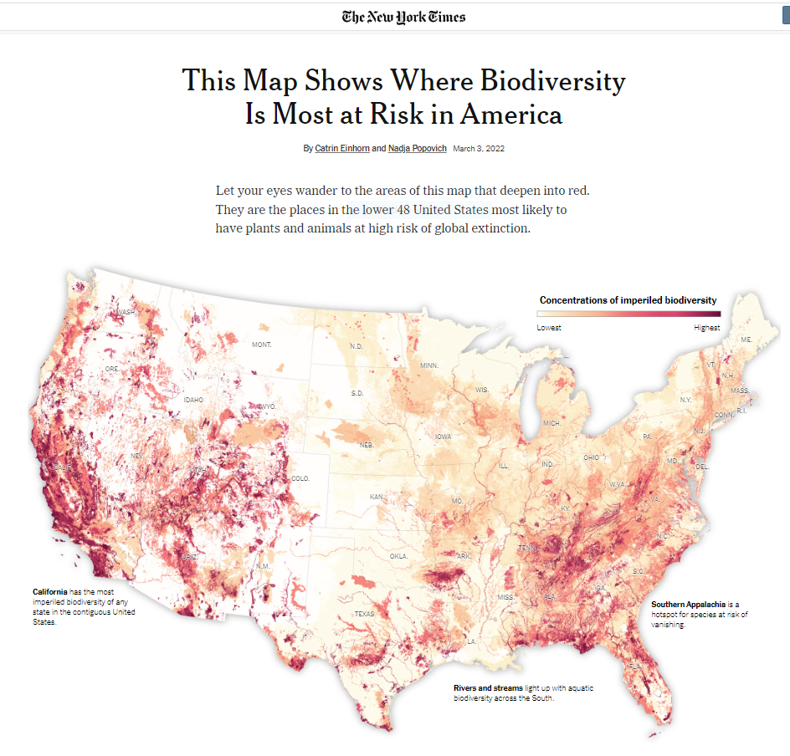
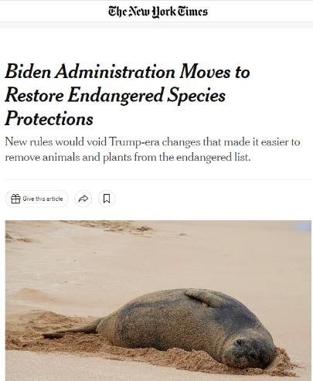
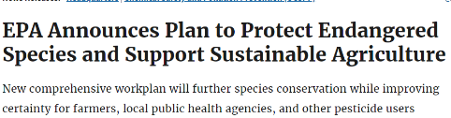
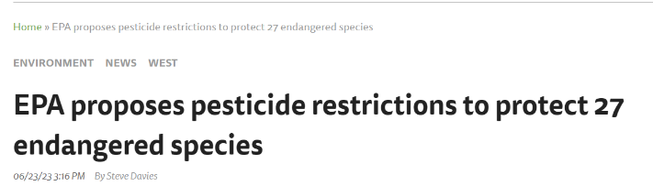
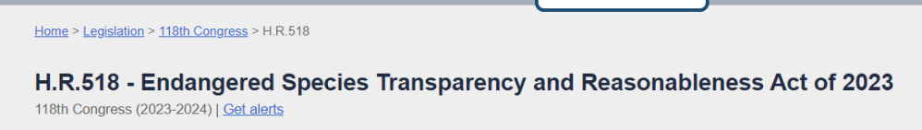
Federal ESA Actions Will Impact Agriculture
Notes:
Sources: FarmProgress, EPA, New York Time (2x), AgriPulse, and Congress.gov

Slide 10



Pesticides, US EPA, The Services
EPA regulates pesticides
  Registration/reregistration
When endangered/threatened species are potentially harmed by a pesticide, law requires consultation with the services
~1,200 registered active ingredients in the US
National Marine Fisheries Service
US EPA
US Fish & Wildlife Service

Slide 11



Endangered Species Act and Pesticides
Challenge meeting ESA obligation:
  Limited resources, etc. = large backlog
Approximately 99% of pesticides are currently vulnerable to court decisions!
Court-enforceable deadlines imposed on EPA:
  Litigations highlight challenges to meet ESA
  ALL pesticides now require ESA reviews

Slide 12
Pesticide Registrations Are a Series of Tradeoffs
Registrant: goal is a marketable product without unreasonable adverse risks to the environment
  Register on appropriate sites (crops) to pay for research, development, manufacturing, and marketing
EPA: goal is to protect human health and the environment
  Mitigation to reduce risks to endangered/threatened species can include: reduce use rate, number of applications, not allow use on a crop, county, or state, require conservation practices to reduce runoff, in field buffer to reduce drift to adjacent areas, etc.
  All of the mitigation practices can impact the user by increasing the cost of production, reducing the area that can be farmed, add management complexity or reducing the pesticides that can be used which can also negatively impact resistance management practices
Notes:
"take" means to harass, harm, pursue, hunt, shoot, wound, kill, trap, capture, or collect, or to attempt to engage in any such conduct

Slide 13
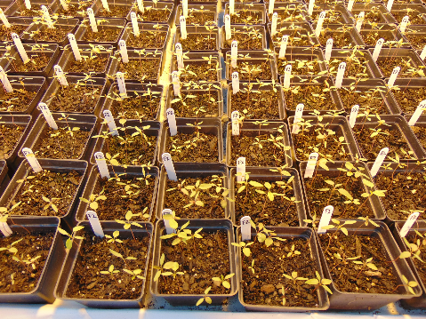
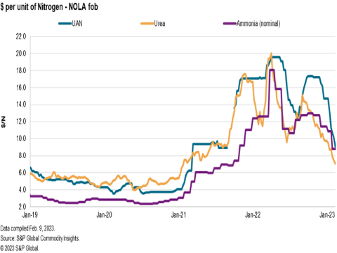




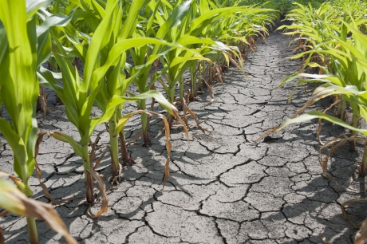
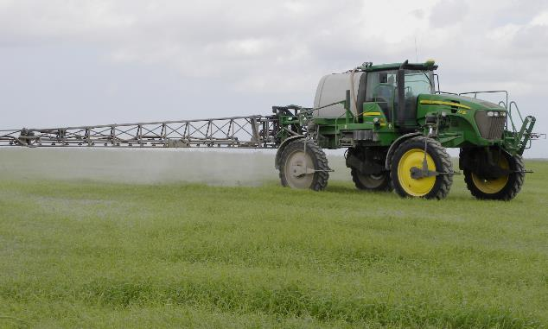
More Challenges for our Farmers!
Pesticide resistance
Fertilizer prices
Global markets
Extreme weather
Regulatory challenges
Water
Pesticide stewardship
……..etc.

Slide 14


Safe, Affordable, Accessible Food, Feed, & Fiber
2.01 million U.S. farms (loss of ~10,000 previous yr )
One farm feeds 166 people a year
86% U.S. ag products – family farms
Current population 8.0 billion
2050 population= 9.7 billion
70% more food produced in 2050
*Info obtained from farm bureau/USDA web site 2022.

Slide 15
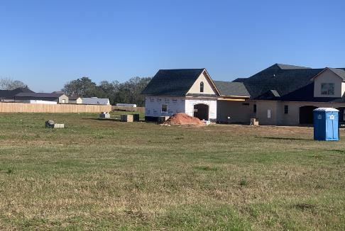
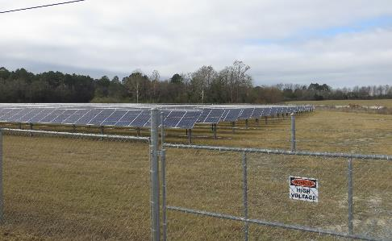
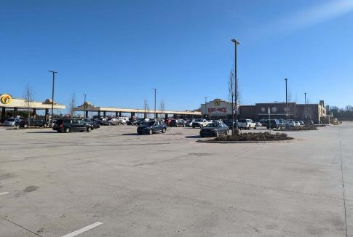


Loss of U.S. Farm Land is Alarming
Farmland lost since 1959 | 289,258,000 acres
Farmland lost in last 10 years | 21,200,000 acres
Farmland lost in last 5 years | 6,970,000 acres
Farmland lost in last 1 year | 1,900,000 acres
Farmland lost per hour over last 10 years | 242 acres
Farmland lost per hour over last 5 years | 159 acres
Farmland lost per hour over last 1 year | 217 acres

Slide 16
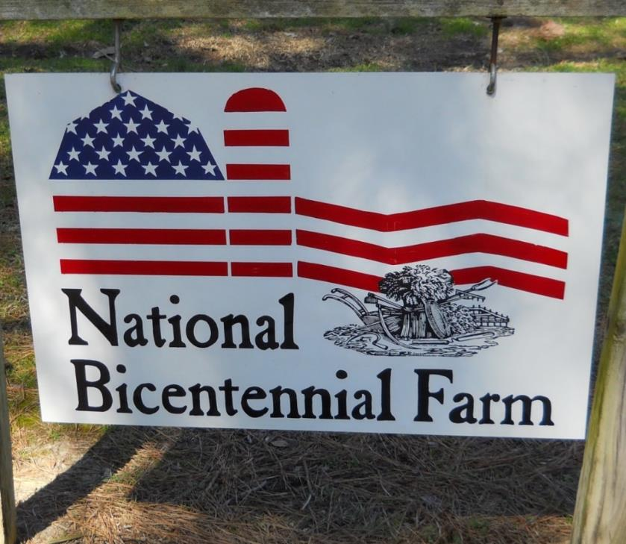
Safe, Affordable, Accessible Food, Feed, & Fiber
Availability of economically effective pesticides with practical use patterns are essential

Slide 17
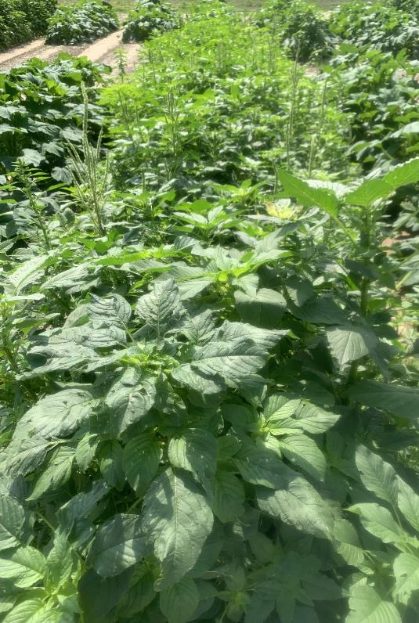
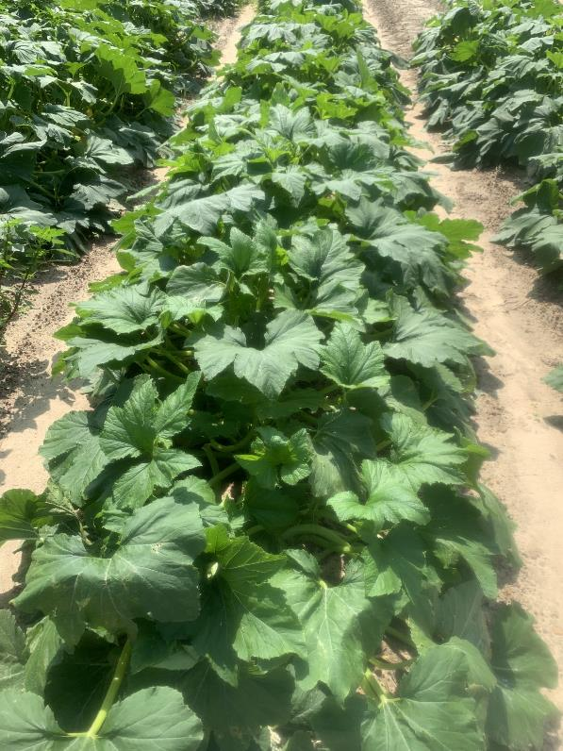
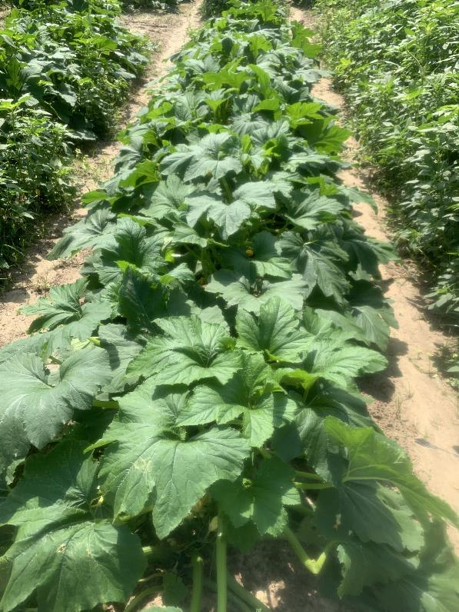
Managing Weeds in Squash With or Without Herbicides*
No management
Herbicide system
No Herbicide – Tine Weeder + Hand Weeding
$0 per acre
$38 per acre
$4041 per acre
*Herbicide system = costs of herbicides + application. No herbicide system = cost to run tine weeder 15 times + labor to hand remove all weeds. Fixed costs, harvest and marketing costs, and variable costs other than weed control are approximately $8370.

Slide 18
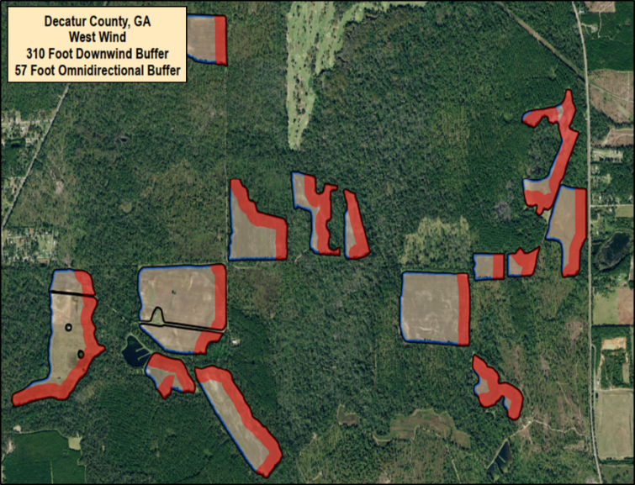
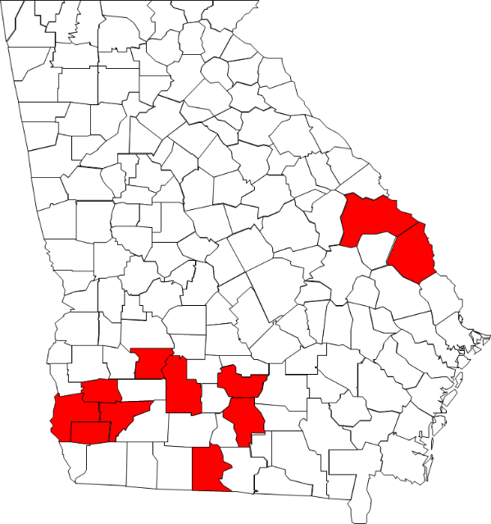
ESA Regulations Remove Tools From Farmers
Potential loss of herbicide by the court.
Currently product-specific, county-level pesticide use restrictions in place
Baker Berrien Brooks Burke Calhoun Early Irwin Lee Miller Screven Worth
County wide in-field buffers
County-wide product loss

Slide 19
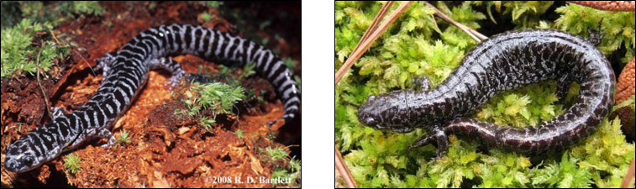
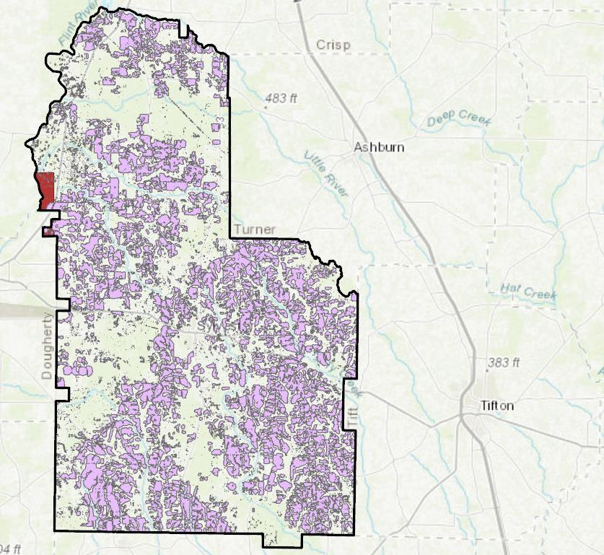
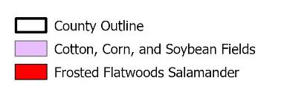
Enlist Duo Removed from 11 GA Counties!
Worth County, GA
0.3% of these crops are within the area identified to have Frosted Flatwood Salamander populations
Acreage Calculations
  122,686 acres of corn, cotton, and soybean
  333 acres in salamander habitat

Slide 20
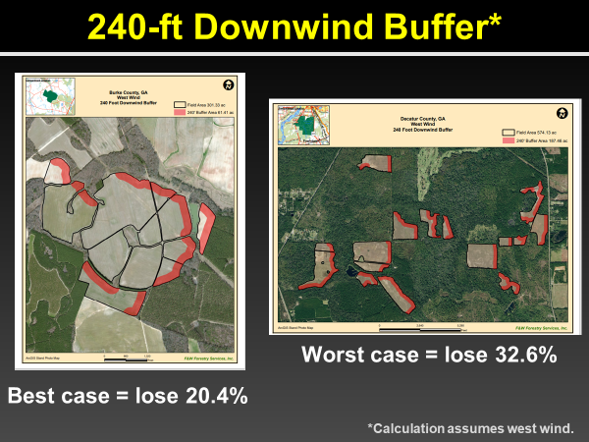
Impact From In-Field Buffers Has the Potential to Destroy Agriculture

Slide 21
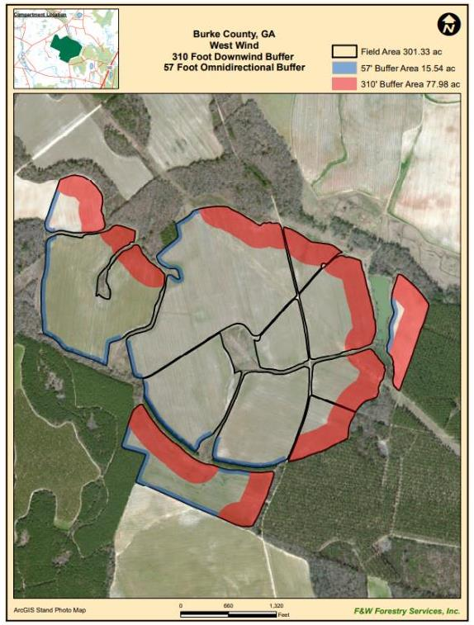
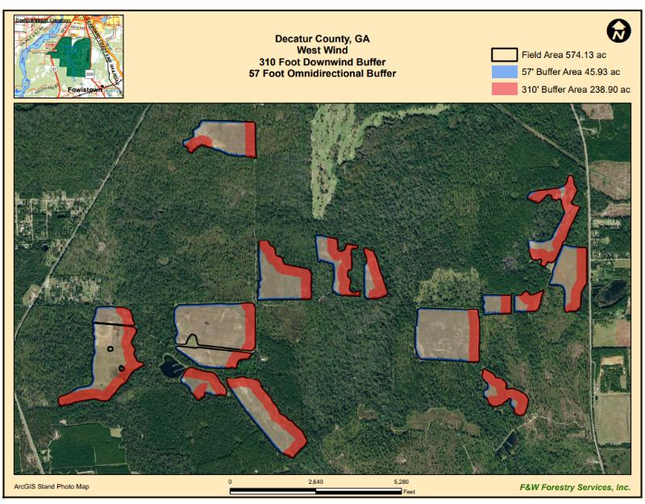
Impact From In-Field Buffers Has the Potential to Destroy Agriculture
Worst case = lose 49.6%
Best case = lose 31%
*Calculation assumes west wind.
Buffer 310 ft downwind plus 57 ft omni directional

Slide 22
University of Georgia Extension Pesticide Complaints

Slide 23





Endangered Species Act & Georgia Pilot Program
Increase the quantity and quality of information available to the U.S. EPA and the Services, so they can make better-informed decisions
In cooperation with
Farmers

Slide 24











Impact Maps Using Historical Info
69,167 acres
OR
7% of total acres restricted from Enlist Duo applications
9,587 ac (13%)
6,534 ac (8.7%)
3,602 ac (4%)
5,312 ac (4.9%)
0 ac (0%)
5,179 ac (4.8%)
7,751 ac (9.4%)
25,331 ac (38%)
Nearly 1,000,000 acres of land prohibited
4,614 ac (5%)
925 ac (1.2%)
333 ac (0.3%)

Slide 25


How to Refine the Map
Learn about the species habitat
  Habitat consists of specific forest wetland composition
  Occupied wetlands appear on landscape in clumped fashion
    2-6 wetlands within 0.5 km radius
    Wetland surrounded by forest
Longleaf pines flatwoods/savanna ecosystem (adult)
We have thoroughly enjoyed working with FWS to understand habitats!
Acidic, tannin-stained ephemeral wetlands (breeding)

Slide 26











Impact Based on Habitat Maps
3,526 acres
OR
0.37% of total acres restricted from Enlist Duo applications
112 ac (0.15%)
310 ac (0.41%)
232 ac (0.26%)
921 ac (0.84%)
144 ac (0.25%)
308 ac (0.29%)
473 ac (0.57%)
163 ac (0.25%)
Over 99.6% of land should not be restricted
148 ac (0.16%)
405 ac (0.53%)
310 ac (0.25%)

Slide 27

Spurious Pixels
Cotton, Corn, and Soybean Fields……………in the middle of a 30+ year old housing development

Slide 28


Cropland Falling Under Enlist Duo Restrictions
100%
0.33%
Refined maps reduce restrictions on over 99.6% of cropland, while still protecting sensitive sites!

Slide 29

Mitigation Plans
Mitigation plans for sensitive sites:
  Document EXACTLY where restrictions are needed and where they are NOT
Plans will focus on:
  On-target pesticide applications
  Minimizing pesticide runoff – NRCS Programs CRITICAL

Slide 30




Pesticide Label Reform Desperately Needed
Accurate Use Rates
Improved applicator understanding
Accurate Application Patterns
Resistance management
Notes:
Maybe we should have an example of 2 different registrants herbicide labels?

Slide 31


Restrictions Driven by Endangered Species Sensitivity
Soybean
The predictions on sensitivity of meadowrue to dicamba are essentially based on that of soybean?

Slide 32


Take Home - My Opinion
Protecting listed species is critical
Having pesticides with practical use patterns is equally as critical
Science is the key to protecting agriculture and our environment
A risk/benefit component to ESA is needed
NRCS critical to adoption of mitigation measures; BUT, programs must be more simple and flexible

Slide 33







Science, Cooperation, & Communication
Farmers
Industry Partners

Slide 34
Q&A
Presentation materials will be
posted at ncfar.org.

